Slide 1
Supporting People Who Live in Hoarded Homes October 25
Lena Gibson
Belongings Support Lead
Debra Myers and Adele Marsden
Community Link Workers
Notes:
My name is Lena Gibson and my colleagues Adele and Debra are here to talk to you about supporting people who live in hoarded homes and how a trauma informed approach is essential.
It is a great pleasure to see so many people who are passionate about health and social care. It really is a fantastic career choice we have made. I think it’s really a privilege to be allowed into people’s homes.
Now some people welcome us in and are delighted to see us but with others just getting through the front door is more of a challenge. And supporting people who live in hoarded homes is most definitely a challenge.

Slide 2
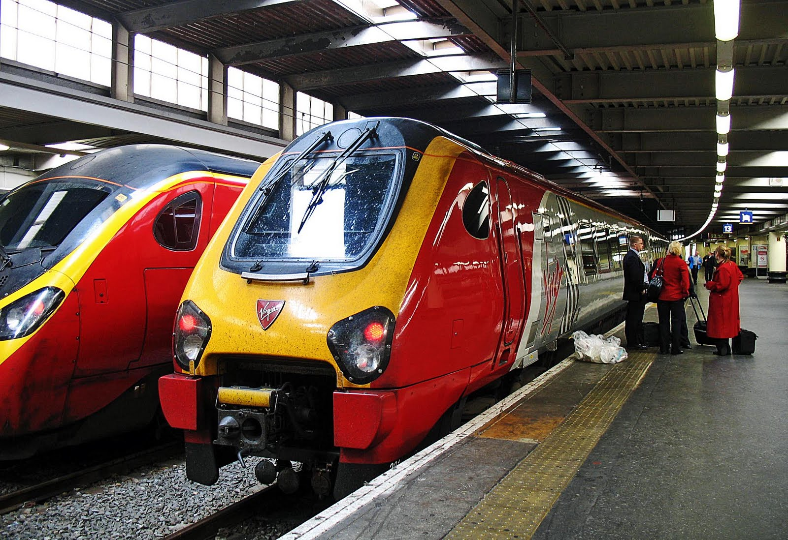
Who am I?
British Rail
OT assistant
Belongings Support Lead
Notes:
So who am I. I am currently the Belongings Support Lead working in the adult social care team at Wigan Council. But my life like everyone else’s has been a bit of a journey.
Supporting people with hoarding behaviours is most definitely a journey – if you do it well.
So really briefly here’s are some details of my journey – how did I come to be doing this.
First off I am a 70’s child, the 70’s was a bit of a tough time in Britain, I remember the electricity going off regularly and my sister crying a lot as she couldn’t do her hair properly before she went out with her friends. No electricity equals no hairdryer. The 70’s turned into the 80’s and thank goodness the electricity was back on because big hair was now in fashion. The 80’s were a time of excess and the consumer culture that is now the norm first started. Mine was the first throw away generation, paper plates and plastic forks and shopping was in in big time. Acquiring more and more and spend spend spend.
I started working for British Rail straight from school way back in 1991. And the Railway is where I picked up my love of working with people and helping them with their journey. I was speaking to hundreds of people some days and they weren’t always at their best. All of life is played out on the railway, births, deaths and marriages are daily occurrence. You had to be a people person and have the skill of building a rapport really quickly.
These skills I transferred to working in Adult Social Care and here I am now in the Safeguarding Team. Working with people who live in hoarded homes. I also spent a good few years as an OT assistant and this is where I learned the principle of breaking down daily living tasks into smaller chunks so that they are more manageable for people.
And why belongings support lead – why not the word hoarding hoarding in my job title – we want to highlight that people’s belongings are an extension of themselves, not just stuff, clutter or junk.

Slide 3
What is hoarding?
Hoarding Disorder - a mental health condition in it’s own right since 2018, it is not a lifestyle choice
WHO 2018, DSM 5 2013
Acquiring an excessive number of belongings
Not being able to let them go
Notes:
So what is hoarding. It is now a mental health diagnosis in its own right, Hoarding Disorder and it has been in this country since 2018.
It was first recognised in America in 2013. And it is most definitely not a lifestyle choice.
There are 2 main parts to hoarding disorder – the first is when people acquire lots of belongings and the second part is not being able to let them go.
Today I might be asking you to think about this issue in a very different way at this session, and everything we are talking about are our own first hand experiences over the last 10 years. We are front line workers and all the cases are real people.

Slide 4
Hoarding Disorder boundaries with:
OCD
Neurodiversity
Psychotic disorders
Eating disorders
Obesity
Dementia
Executive functioning difficulties
Notes:
To complicate matter further, with what is an already complex issue, HD also boundaries or there is an overlap with
OCD
Neurodiversity
Psychotic disorders, schizophrenia seems to be common anecdotally
Eating disorders
Obesity
Dementia
Overarching all those conditions are executive functioning difficulties.
Things like planning organising or prioritising, managing emotions, motivation etc.

Slide 5
Why do people hoard?
Trauma or crime
Bereavement
Neurodiversity
Cognitive issues that affect decision making and problem solving
Anxiety and/or depression
50%
Lack of control in other areas of
their life
Excessive guilt
about waste
Abuse
Chronic disorganisation
Empty nest syndrome
ADHD and Autism Spectrum
Genetics and family history, hoarding behaviours often runs in families
Sentimental reasons – to help recapture a time when life felt good and secure
Other mental
health conditions
Other health conditions
Notes:
To pick out the top 3 reasons behind hoarding and clutter issues
Bereavement, Trauma and Neurodiversity
The Why. There is nearly always a why behind hoarding behaviours or clutter. Often there is more than one why.

Slide 6
Trauma Informed
Safety
Trust
Choice
Collaboration
Empowerment
Cultural Consideration
6 underpinning
principles
Notes:
So how can a trauma informed approach help us when we are trying to work with people who hoard or have lots of clutter.
Here are the 6 principles of trauma informed practice.
Safety, Trust, Choice, Collaboration, Empowerment and in Wigan we also have Cultural consideration.
If you are really good practitioner you will be doing trauma informed practice already, you may just not know it. If you are working in social care because like me you have lived experience of being in the system you hopefully will already know what a really good worker should look like.
So lets take each of the principles and break down what this might look like in day to day practice.
Safety – How can we ensure that individual feels safe with us and we can work together - make sure you meet the person somewhere they are comfortable with at first. This might be at a café, the park etc, a friend or relatives home rather than at their home at first. Give people the opportunity to get to know you for a few visits before you even broach the subject of having lots of belongings. Provide clear information and schedule consistent appointments. Routine - stick to the same day and time for appointments if you can. And a big part of trauma informed also asks us to look after ourselves as a worker. You must take care of yourself to avoid burnout and vicarious trauma.
Trust – you need to earn the person’s trust. Never turn up unannounced. Be on time, never be late or cancel appointments. I am sat in my car around the corner for at least 10 minutes before every appointment so that I am on time. At the very least ring if you are going to be late. Be prepared, read all the notes, even the paper stuff in the basement. Be honest about what we can and can’t do, be non-judgmental, compassionate and kind. Your attitude is key. Maybe you could help with things unrelated to the excess belongings, in order to build a relationship.
Choice – People need choices. Don’t prescribe, address the power balance between individual and professional; I am advocating for an equal balance of power, people must make their own life plans. This is very tricky in some cases for example when there are risks to children or other cared for individuals or when statutory responsibilities are an issue, getting in to service the gas boiler or if mould or damp needs investigating for example.
Collaboration – How can we work together – I like the phrase relationships heal through relationships. Again you may need to do things that are strictly not within your job remit. Be genuine and encourage connecting to the community. This is one area where peer support really comes into it’s own and well be sharing some information with you about our peer support groups in Wigan.
Empowerment – Ultimately we are trying to empower people to make their own choices. When people have experienced abuse they have often had their ability to make choices removed from them. We need to respect individual’s choice and empower them to make their own decisions. We need to obtain informed consent, explain how information will be shared, the limits of confidentiality, give people options and discuss what they would like to happen. Support may be needed to build self esteem, relearn boundaries and learn to emotionally regulate in a safe way.
Cultural consideration – be aware of the impact of culture on behaviour, attitudes and values. Be aware of gender, men often need a different approach to females.

Slide 7

Extending an olive branch
How do we get through the door?
persistence over resistance
Reluctance to engage v. organizational pressures
Time / connection / your attitude
Gentle encouragement
Identify and address barriers to support
Don’t close, reallocate
↑ Increase quality of life
↑ Improved functionality
↓ Reduce risk
Notes:
How do we address non engagement, I like to call this extending an olive branch.
How do we even get through the door sometimes, I have spent quite a bit of time talking through the letter box and by texting people at first.
We need to identify and address the barriers to accepting support. This does take time and considerable effort. But if we don’t and you close the case, I can almost guarantee the case will come in again, perhaps a year later and the levels of clutter and risks will have increased.
Taking the time and your attitude or approach is so important.
I am advocating for gentle encouragement, we don’t want to push too hard or not enough because there are lots of risks to living in hoarded homes and without support it is very unlikely those hoarding behaviours will change. Try re-allocating cases rather than closing. A different worker might have a different approach or it might be a personality thing.
Local authorities are often in a unique position – we can be both offering support and prosecution.
I am advocating for a middle ground – gentle encouragement.
Enforcement should be a last resort after multiple attempts have failed and we can evidence this
Progress can be measured by reduced risk, improved quality of life and improved functionality

Slide 8
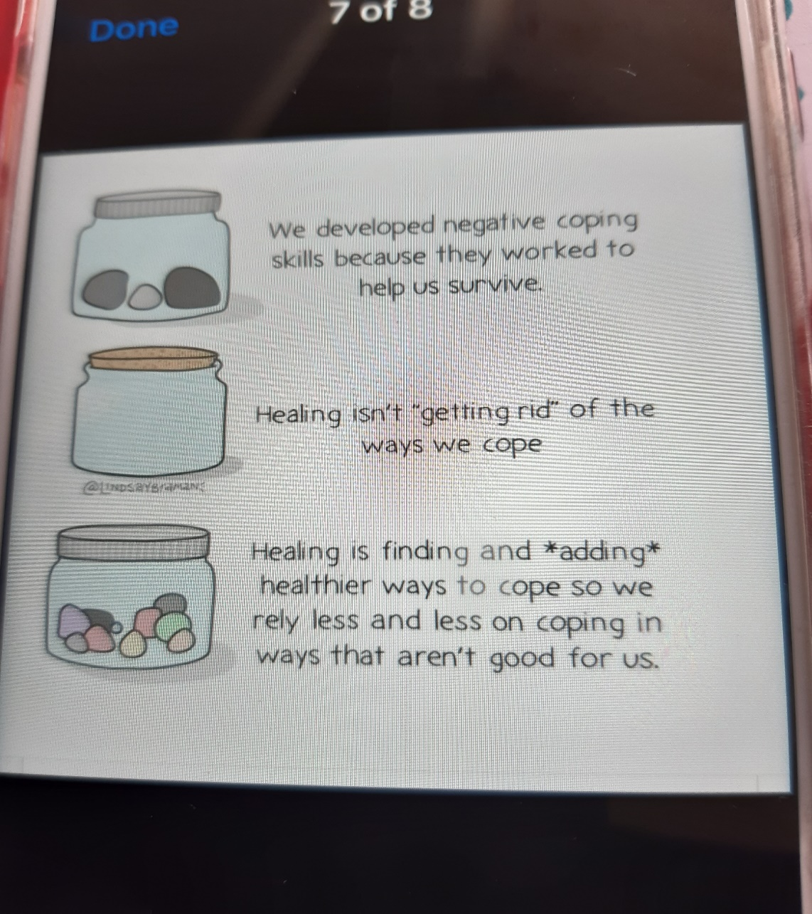
A problem V. a solution
Hoarding is usually a symptom of something else
Individuals can be seen as the problem rather than a person in need of support
Often individuals see hoarding behaviours as a solution
Notes:
As professionals we often see hoarding behaviours as a problem but individuals often see them as a solution.
Hoarding or clutter is generally a symptom of something else. When people’s mental health goes down the clutter goes up.
I recently heard addictions described as A Darker Occupation and I thought that could apply to hoarding behaviours too.
Individuals with hoarding disorder can be seen as the problem rather than a person in need of support. The behaviours are mistakenly treated as breach of tenancy or as ASB. The root cause and wellbeing of the person is often completely overlooked.
Often individuals see hoarding behaviours this as a solution. They can be a purposeful and meaningful occupation. They provide a sense of control, security and safety, a way of expressing their identity and self-expression, it can be a coping mechanism for life.
One lady I spoke to recently told me she was the go to person in the street for all her neighbours if they needed anything. Ask Joan she will have one. If I let go of all my belongings and I’m no use to anyone, “who will I be she asked me”.
And going back to hoarding being a coping mechanism we can’t come in and rip away someone's coping mechanism for life.
We all have the urge to direct our own lives, this is the basis for ethical support, and I want to remind you about another pointer, here in social care we have something called Unconditional positive regard, we don’t judge, pls have a think about how can we ask other services to adopt this approach.
REMEMBER, Hoarding is usually a symptom of something else.

Slide 9
The Wigan Way
See the person
Listen deeply
Know this place
Do the right thing
Connect to neighbourhoods
Show our love and pride - be kind
The person who says “that’s not my job” is usually right.
It’s not their job.
It’s their opportunity.
And they just announced they don’t want it.
Notes:
So at Wigan what are we doing differently.
At Wigan I was trained, trusted and given the time to try something different. We have a culture of positive risk taking, being innovative, and we are given the permission to try new ways of working.
The Wigan Way is about seeing the person. Listening deeply – listen to understand not to respond. Have good local knowledge so we can connect people to their neighbourhoods and services. And my favourites being kind and doing the right thing.

Slide 10
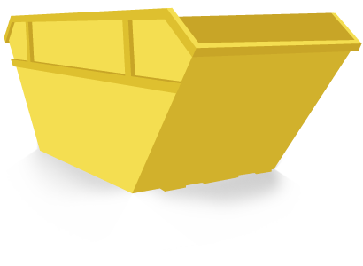
The Wigan Way
Deep cleans don’t change the behaviours
Encourage people to seek support
Trauma behind the behaviour needs understanding
De-cluttering is not treatment
Toolkit
Training
Peer Support Groups
Ditch the
Skip
Another trauma
97%
failure
Notes:
If you take nothing else away from today let it be this. Ditch the skip. Deep cleans to not work. They cost a lot of money and they do not work.
They are another trauma for people.
The failure rate of deep cleans is over 97% (Bratiotis, 2011) They do not change the hoarding behaviours.
Pls note decluttering is not treatment. De-cluttering is not de-hoarding. We have found that the most effective combination of support for people is a mixture of
Talking therapies
Motivational Interviewing
Practical hands on de-cluttering support
And life coaching skills
In Wigan we have a Hoarding & Clutter Toolkit, you can have a look at this on-line, just google wigan hoarding toolkit and it comes at the top of the list. The toolkit shares good practice and complements our training offer around this.
And lastly we will tell you more about the peer support groups in the borough in a minute

Slide 11

Support should never feel like punishment
It should feel like safety, choice and dignity
Notes:
Another key message from us today, support should never feel like punishment.
Everyone wants to feel safe and have their dignity

Slide 12
Best practice
What is helpful – think addiction - impulse control disorder
Trained
Trusted
Time
Patience
Listening - listen to understand not listen to respond
What is not helpful
Pressure
Stigma
Notes:
Best Practice, what is helpful – think of this in the same way that we think about addiction.
Staff need to be well trained so they have the confidence to work on these cases. They are unique and the most complicated and complex cases out there. The compulsive acquisition part of hoarding disorder is linked to impulse control disorder. We are doing something even though we know it is bad for us.
Staff need to be trained and up-skilled on this issue, otherwise we can get this badly wrong.
People need to trust us to work with them
It does take time – lots of it and Patience. This is not my strong point and I have had to learn to sit on my hands.
Listening skills - you all know how important listening skills are – an absolute essential for anyone working in social care.
And what is not helpful
Pressure - pressure equals more hoarding, remember this is the person’s go to coping mechanism
And stigma, shame and judgement perpetuates this issue. We need to normalise it. We need to talk about it.
And that leads nicely to my colleagues Debbie and Adele who are going to tell you all about our peer support groups where talking about it is positively encouraged.

Slide 13
Belongings Peer Support Group
A safe place
Be with like minded people
You can just listen
No shame
Reduce stigma
Normalise this issue
Can discuss wider issues and signpost
Solution focused
Welcoming
Accepting
Tea and Biscuits
“They are a wise bunch, and we learn lots” Debra

Slide 14
Thank you
Q & A
l.gibson@wigan.gov.uk
Notes:
Thank you for your interest in this tricky subject

